Slide 1
IHM1213 Food and Beverage Service and Operations
Lesson 3: Restaurant Presentation
Arj. Inah Bancoro

Slide 2
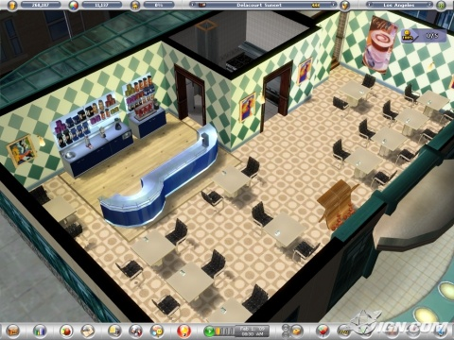
Scope
Fine Dining Concept
Setting Atmosphere
Layout and Space Planning

Slide 3
Objectives
By the end of the session, the student will be able to:
Describe the fine dining concept
Describe how to set atmosphere in the restaurant
Identify principles in layout and space planning

Slide 4
Review
Food and Beverage Outlets
Food and Beverage Organization Chart

Slide 5
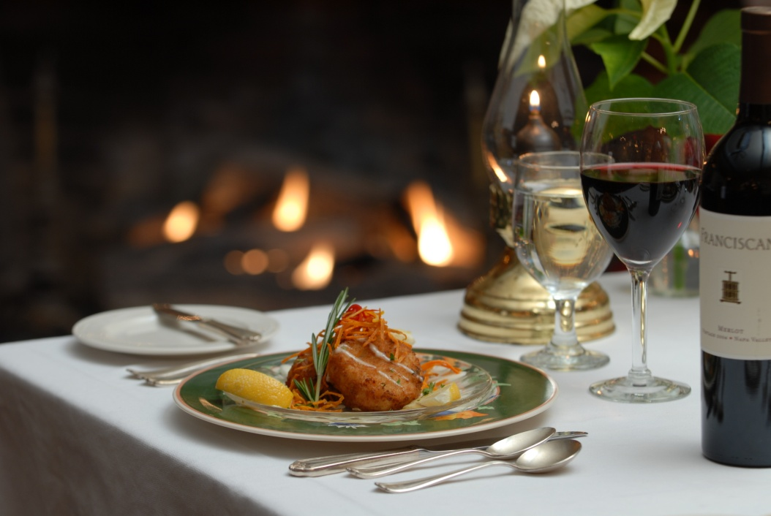
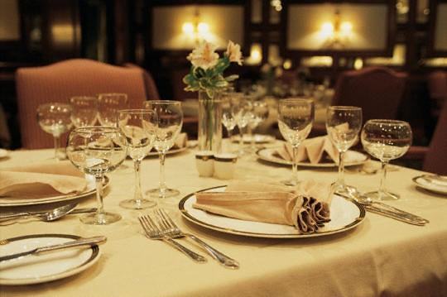
What is Fine Dining?
Notes:
What restaurants are not fine dining?

Slide 6
Fine Dining vs Casual Dining
 | Fine Dining | Casual Dining
Dress Code | Formal | Less formal
Kids friendly | Not really | Yes
Ambiance | Relaxing; Pleasing | Fast pace
Menu | Classic | Loud; Catchy
Portion | Calorie-conscious | Full-loaded
Ingredients | Healthy; Innovative | Familiar

Slide 7
Fine Dining Service
It refers to provision of full service.
It offers specific meal courses or limited varieties.
The menu type is sophisticated.
The food portion offered are generally appealing.
Guests are required to adhere to certain rules and specifications.
Notes:
What services?

Slide 8
Fine Dining Concept
Menu
Service
Atmosphere

Slide 9
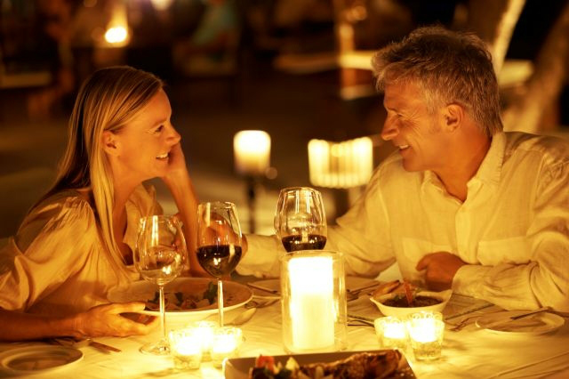
Setting Atmosphere

Slide 10
Setting Atmosphere
In harmony
Appealing presentation
Set tone and feeling of the visit

Slide 11
How to set atmosphere in your Restaurant?
Décor and Furnishings
Lighting
Cleanliness
Music
Staff
Presentation
Technology

Slide 12
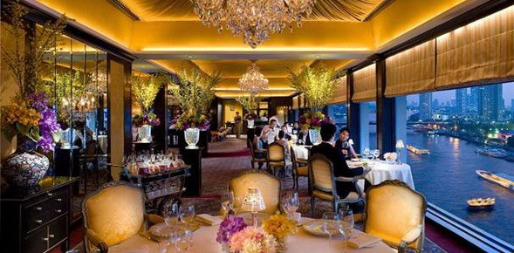
How to set atmosphere in your Restaurant?
Décor and Furnishings

Slide 13
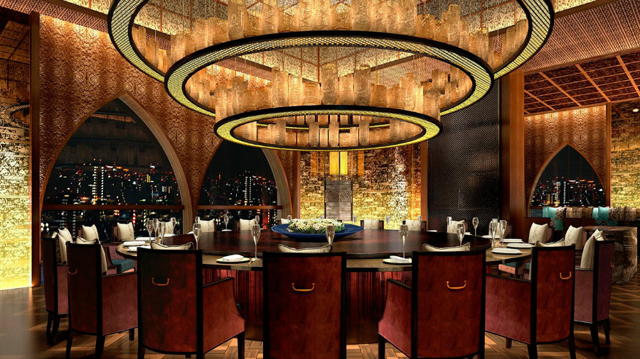
How to set atmosphere in your Restaurant?
Lighting

Slide 14
How to set atmosphere in your Restaurant?
Cleanliness

Slide 15
How to set atmosphere in your Restaurant?
Music

Slide 16
How to set atmosphere in your Restaurant?
Staff

Slide 17
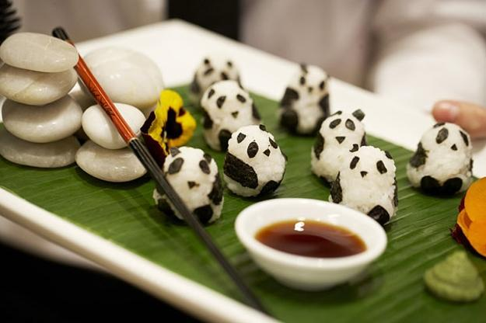
How to set atmosphere in your Restaurant?
Presentation
Technology

Slide 18
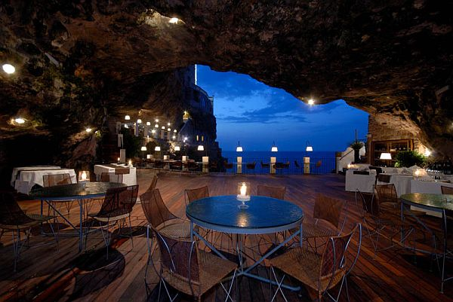
The Summer Cave, Italy

Slide 19
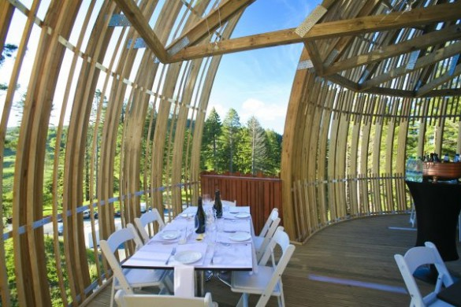
Redwoods Treehouse, New Zealand

Slide 20
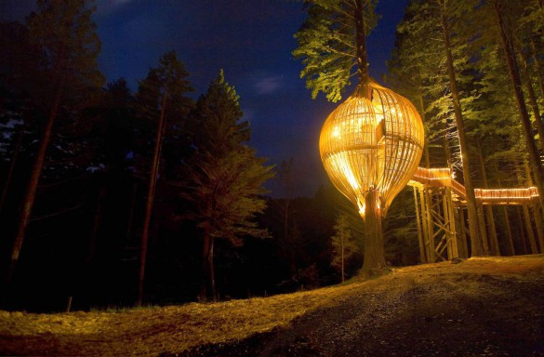
Redwoods Treehouse, New Zealand

Slide 21
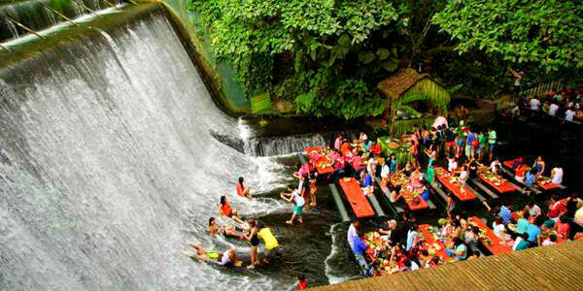
Villa Escudero, Philippines

Slide 22
Villa Escudero, Philippines

Slide 23
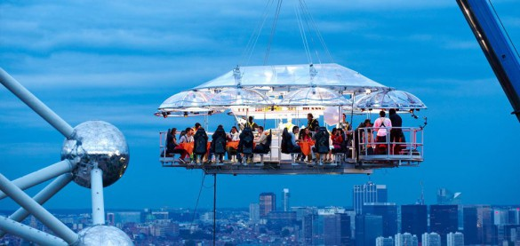
Hanging Restaurant, Belgium

Slide 24
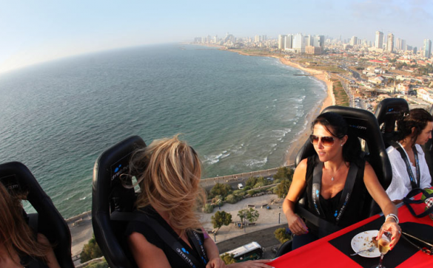
Hanging Restaurant, Belgium

Slide 25
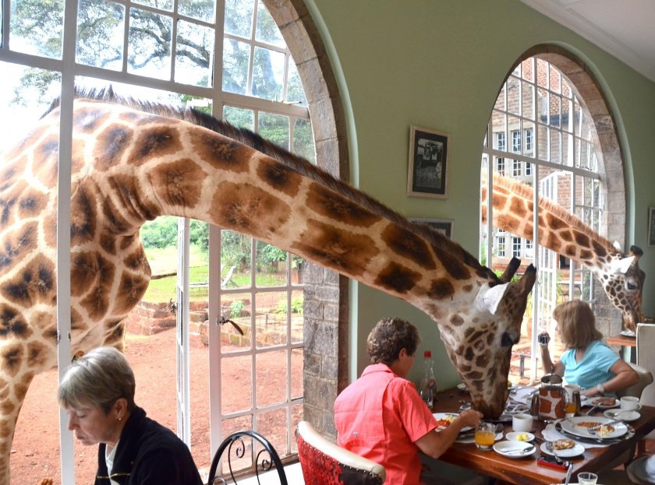
Giraffe Manor, Kenya

Slide 26
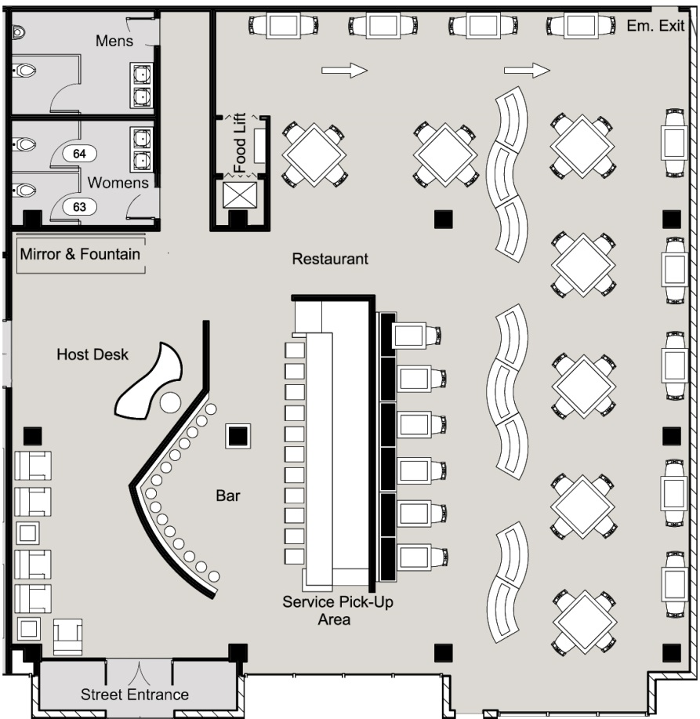
Layout & Space Planning
Notes:
Why is lay out and space planning important?

Slide 27
Layout & Space Planning
Not too many and too few tables in the restaurant!

Slide 28
Activity – Breakout rooms
Find a pair.
Choose a fine-dining restaurant.
Describe its concept based on the following aspects:
Menu
Service
Atmosphere

Slide 30
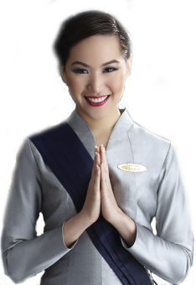
Thank you

